Slide 1
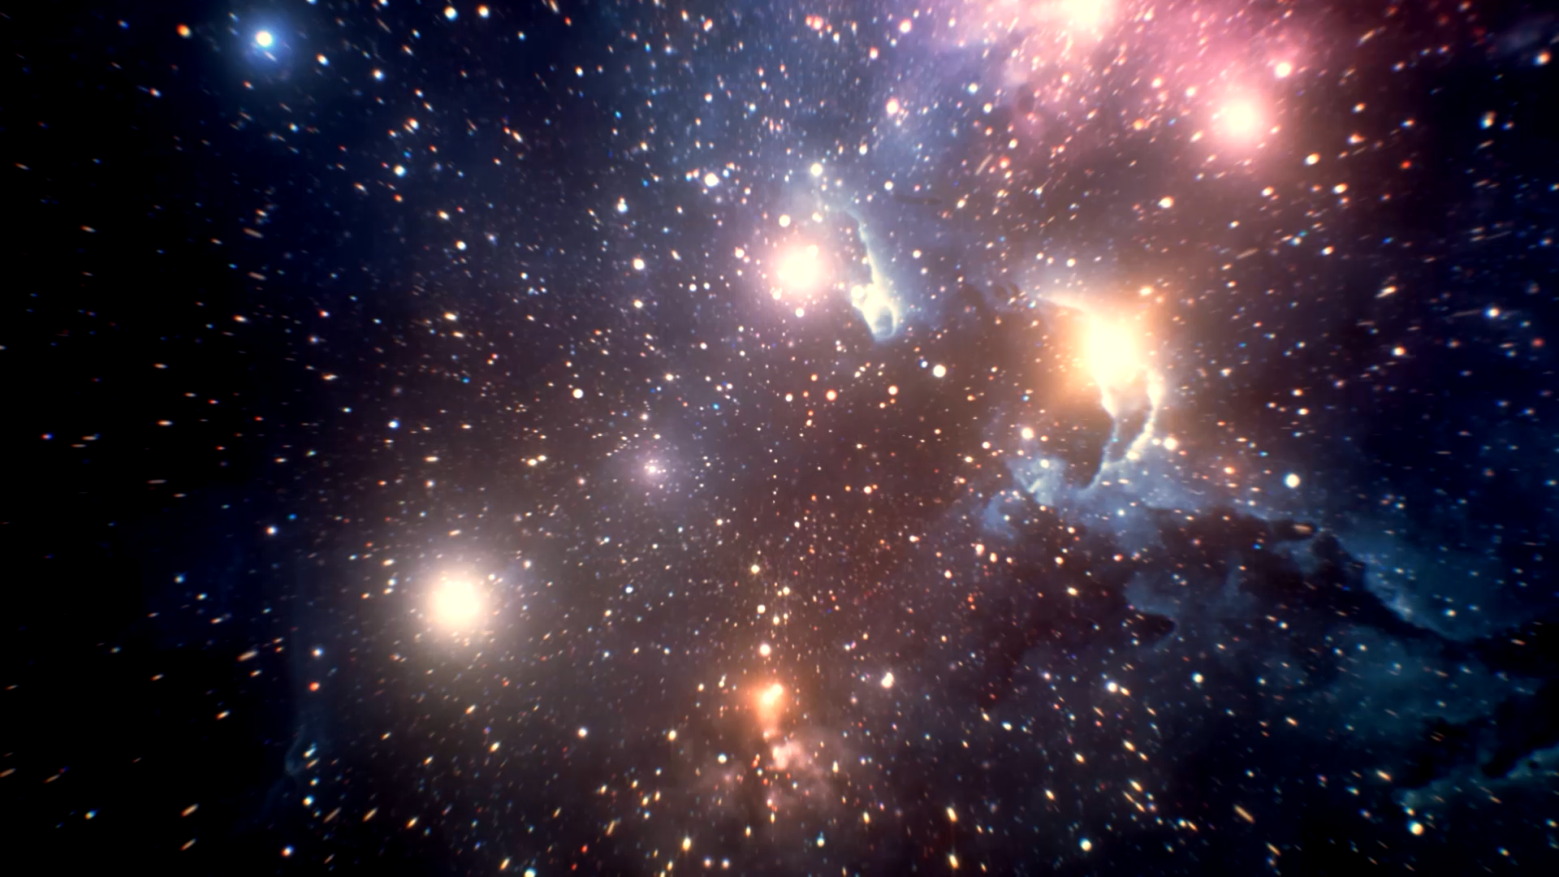
Atoms and Light
The Universe
IS #3

Slide 2
Lecture Recap
What is one thing you remember from the lecture?

Slide 3
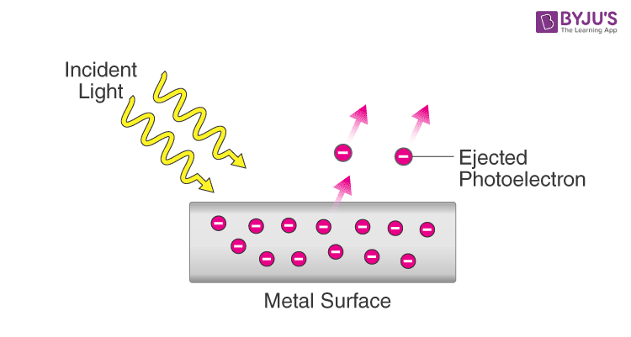
Wave-particle duality
OR
Particle
Wave

Slide 4
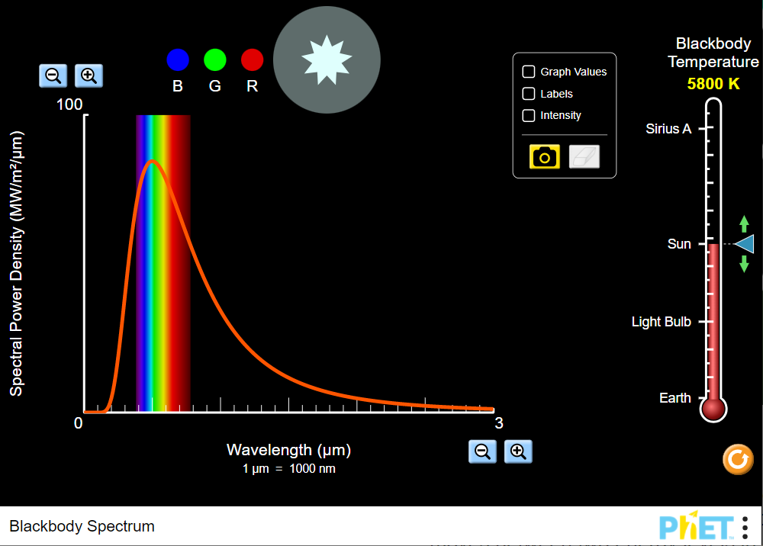
Ultraviolet Catastrophe
Light was quantized to avoid infinites!

Slide 5
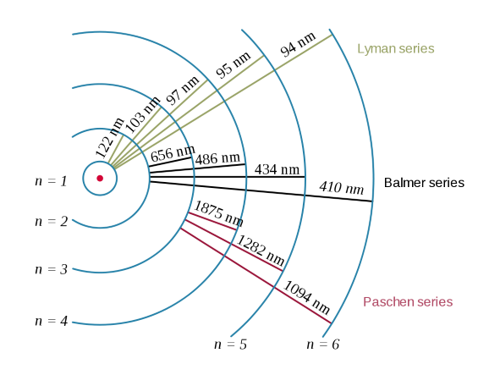
Bohr Model
Electron moves in circular orbit around the nucleus
The angular momentum of the electron is quantized
Electrons can transmit between allowed orbits by emitting or absorbing a photon

Slide 6

Discussion Questions

Slide 7
Q1
Waves exhibit superposition. What physical phenomena are a result of superposition of waves?

Slide 8
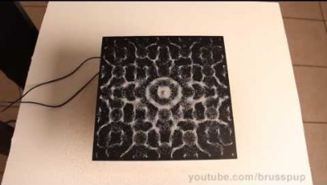
Chladni Plates

Slide 9
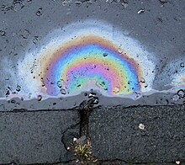
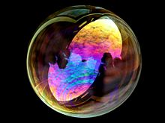
Thin-film Interference

Slide 10
Q4
How is spectroscopy used in other areas of science? Name some examples!

Slide 11
Q4
How is spectroscopy used in other areas of science? Name some examples!
- UV-vis spectroscopy (Finding out concentration of compounds within a solution)
- Fourier-Transform Infrared Spectroscopy (Identifying elements from an unknown sample)
- Raman spectroscopy

Slide 12
Q3
How did Einstein use the particle model of light to explain the findings of the photoelectric effect experiment?
Notes:
Suppose we were to use the model of light as waves, then if we were to shine a higher intensity light, we should expect more photoelectrons to be emitted. Furthermore, we also expect no change to the number of photoelectrons when wavelength of light is changed. However, experiments show that a low intensity UV light emits photoelectrons while high intensity IR light does not emit photoelectrons.

Slide 13
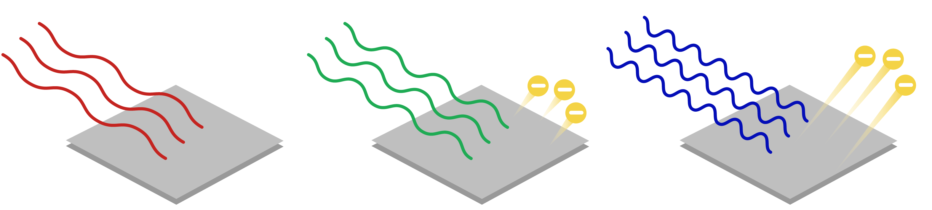
Q3
How did Einstein use the particle model of light to explain the findings of the photoelectric effect experiment?
Wave Theory: Shine a brighter light (higher intensity) and more photoelectrons should be emitted, and with higher energies. Number of emitted electrons and frequency of light are independent.
Reality: Experiments show that a low intensity UV light emits photoelectrons while high intensity IR light does not. Photoelectrons are only emitted when light exceeds a certain frequency.
Thus, the photoelectric experiment showed that light wasn’t just a wave but exhibited particle-like behavior.

Slide 14
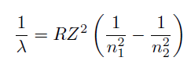
Q5
Derive the Rydberg formula using the Bohr model. Evaluate the Rydberg constant R.
Notes:
(Hint: Use Eqn 3.16)

Slide 15
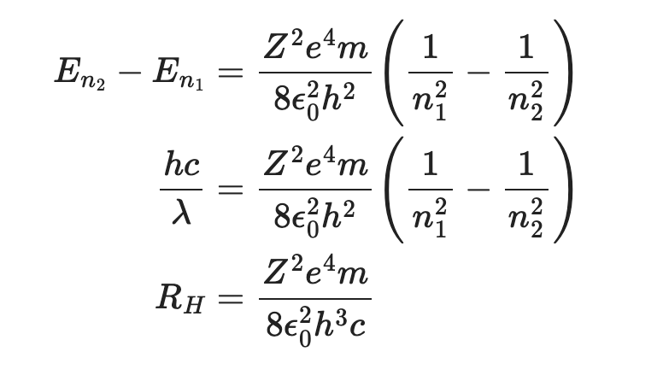
Q5

Slide 16
Q6
Plot the spectra of the Lyman and Balmer series computationally.

Slide 17
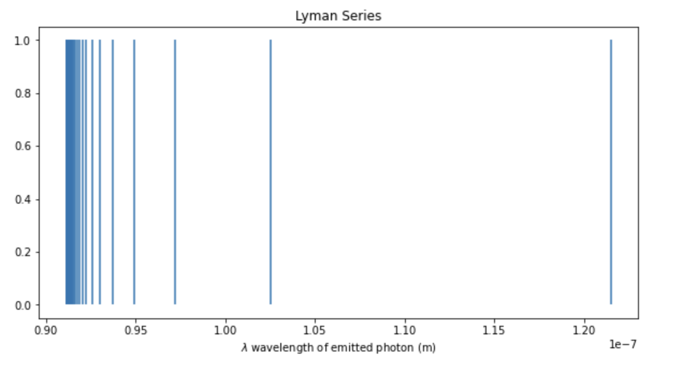
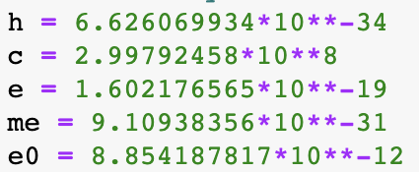
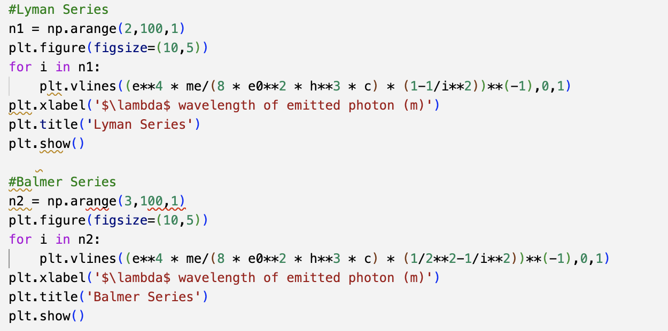
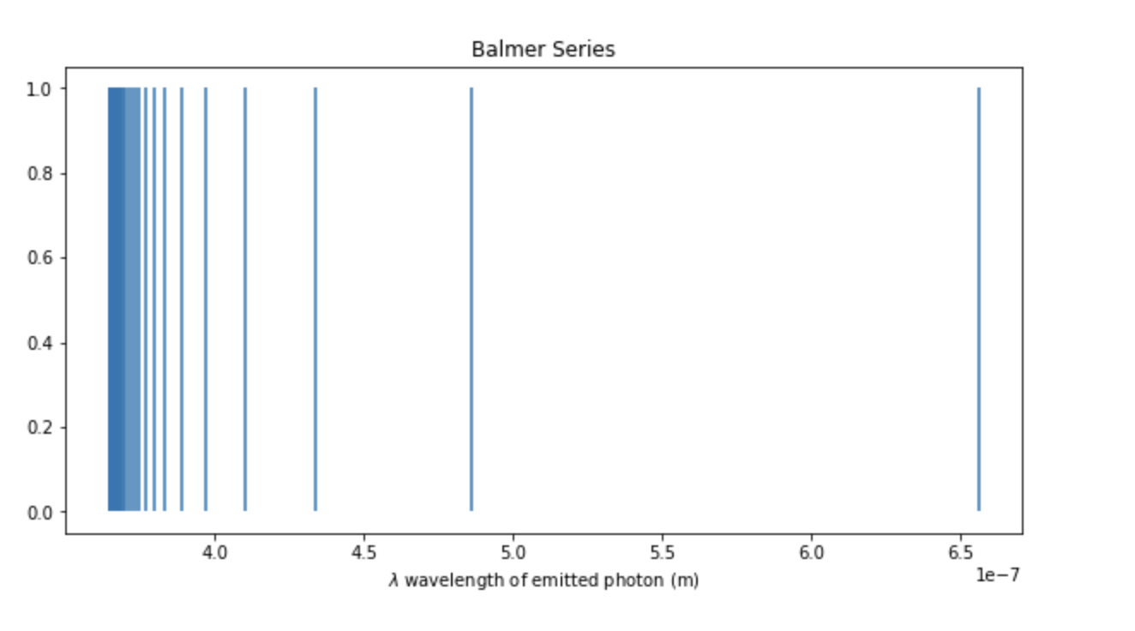
Q6

Slide 18
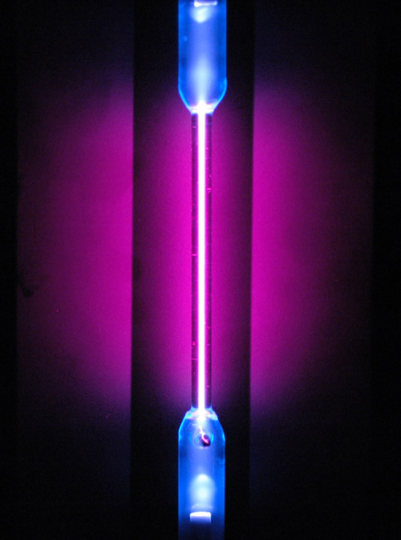
Atomic Spectroscopy Experiment (Part 1)
Use the hydrogen lamp to familiarise yourself with the dry lab spectrometer.
Identify the unknown gas-discharge lamp.
Deadline: Week 8 Oral Viva

Slide 19
Atomic Spectroscopy (Part 2)
2A
Build your own solar spectrometer
Analyse the solar spectrum and identify Fraunhofer lines
2B
Analyse stellar spectrum (at least 2)
Deadline: Week 11 Saturday
OR

Slide 20
Safety
Do not look directly at the emission lamps for prolonged periods.
Do not touch the discharge tube when the emission lamps are switched on.
Do not hold the emission lamps by the discharge tubes. The discharge tubes are fragile.
Take regular breaks to prevent strain on your eyes.
Do not touch any electrical terminals during the experiment.
Always start the experiment with the lowest gain setting on the light sensor and increase as needed.
Do not look directly into the Sun. Wear protective eyewear if necessary.
Look for a mentor for your 1st session

Slide 21
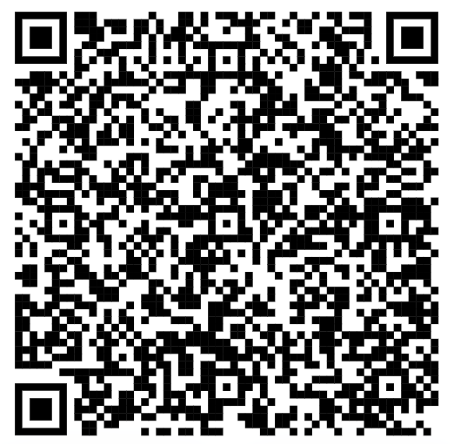
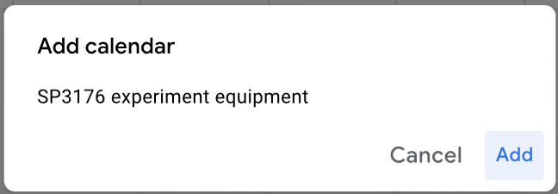
Booking equipment
Access the Google Calendar (https://calendar.google.com/calendar/u/0?cid=Y19tOGNubWhuNjdkNmlhY2VuNGFuZ2c2Y2NyMEBncm91cC5jYWxlbmRhci5nb29nbGUuY29t)
Click “Add” if first time entering the Google Calendar

Slide 22
Booking equipment
Indicate your Group Name and Equipment Booked
Ensure you have booked on the correct calendar “SP3176 experiment equipment”
Once successful, you will see it as “saved”

Slide 23
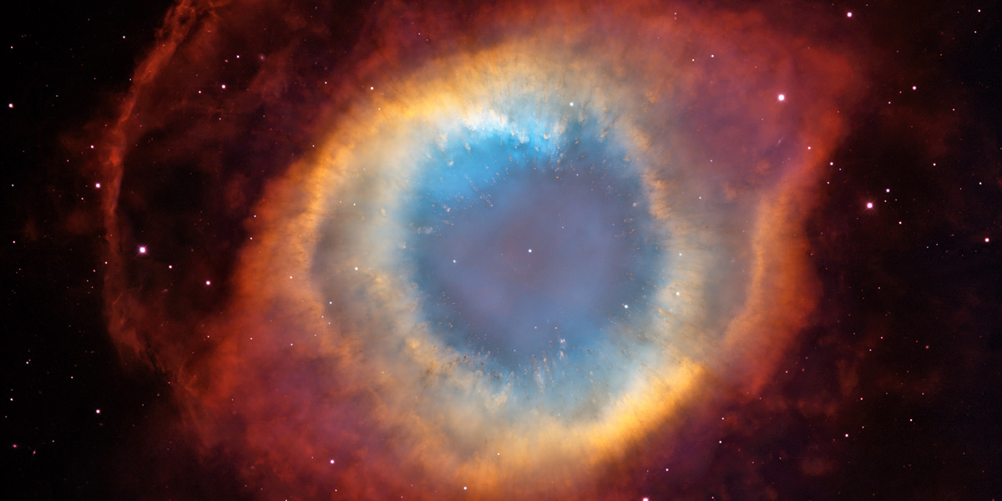
What gives the nebula colour?
(Hubble space telescope)

